Slide 1
Program for Plagarism and Image Resize

Slide 2
INTRODUCTION TO PLAGIARISM
Plagiarism refers to the act of using someone else's ideas, words, or work without giving them proper credit, and presenting it as one's own.
Plagiarism is widely considered an unethical and dishonest practice in academic, professional, and creative contexts. It undermines the principles of integrity, originality, and intellectual honesty.
Copy-and-Paste, Paraphrasing Without Attribution, Self-Plagiarism, Patchwriting are some of the types of plagiarism.
is widely considered an unethical and dishonest practice in academic, professional, and creativeanntexts. It undermines the principles of integrity, originality, and intellectual honesty.

Slide 3
CONSEQUENCES OF PLAGIARISM
Academic Penalties: Plagiarism can lead to severe consequences in educational settings, including failing grades, academic probation, or even expulsion.
Professional Repercussions: In professional and creative fields, plagiarism can damage one's reputation, career, and legal standing.
Legal Consequences: Depending on the severity, plagiarism may result in legal actions, especially in cases of copyright infringement.

Slide 4
PREVENTION,DETECTION AND SOME TECHNOLOGICAL CHALLENGES OF PLAGIARISM
Plagiarism Detection Tools: Institutions and individuals use software tools to scan and identify plagiarized content.
Education and Awareness: Promoting awareness about the importance of academic integrity and the consequences of plagiarism.
Technological Challenges:
Internet Influence: The ease of accessing information online has increased the risk of unintentional plagiarism.
Cut-and-Paste Culture: Technology facilitates quick copying and pasting, making it imperative for individuals to be vigilant about proper attribution.

Slide 5
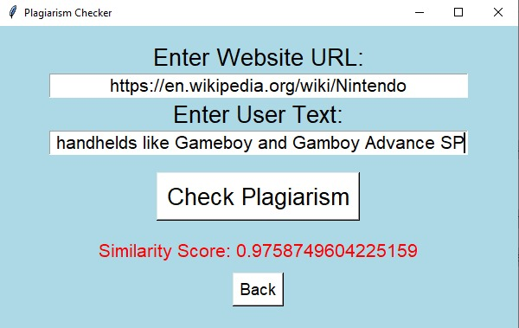
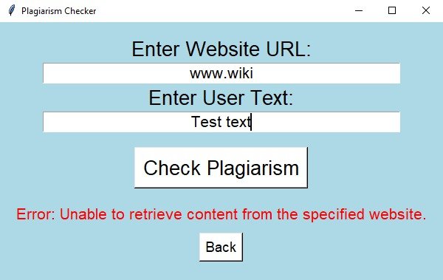
PREVENTION AND DETECTION OF PLAGIARISM THROUGH USER INTERFACE
We developed a User interface that allows detection of plagiarism ,When we enter the website URL, then followed User Text it checks for plagiarism and gives similarity score.
IMAGES OF OUR PROJECT:

Slide 6
SUMMARY OF PLAGIARISM
Plagiarism is a serious ethical issue that extends beyond academic settings, impacting various aspects of professional and creative endeavors.Upholding principles of originality, proper citation, and intellectual honesty is crucial for personal and societal growth, knowledge dissemination, and the advancement of human understanding.

Slide 7
INTRODUCTION TO IMAGE RESIZE
Image size reduction, also known as image resizing or downscaling, is the process of decreasing the dimensions (height and width) and overall file size of a digital image while maintaining its visual quality.
Importance of Image Size Reduction:
Web Optimization: Smaller image sizes contribute to faster website loading times, enhancing user experience and improving website performance.
Storage Efficiency: Reduced file sizes save storage space, especially important in contexts where memory or disk space is limited.

Slide 8
METHODS OF IMAGE SIZE REDUCTION
Resampling: Adjusting the pixel dimensions of an image, often involving interpolation algorithms to maintain visual quality.
Compression: Utilizing image compression techniques to reduce file size while attempting to preserve perceptual quality.
Cropping: Removing portions of an image to decrease its overall dimensions.

Slide 9
REAL LIFE APPLICATIONS OF IMAGE RESIZE
Web and Mobile Applications: Resizing images for web and mobile applications helps in achieving quicker loading times, crucial for user engagement.
Social Media Platforms: Social media platforms automatically resize images to optimize bandwidth usage, ensuring faster upload and download times.
E-commerce Websites: On e-commerce platforms, resizing product images can enhance the overall website performance, leading to increased sales.

Slide 10
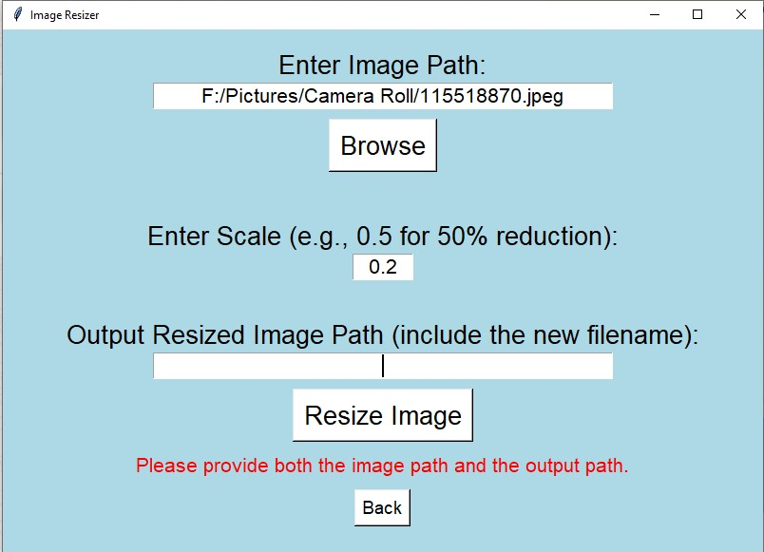
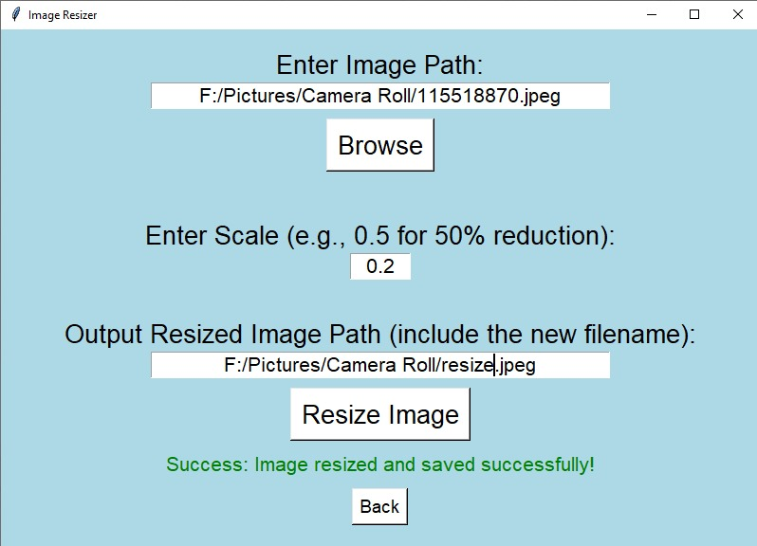
IMAGE RESIZE THROUGH USER INTERFACE
We developed a User Interface in which if we enter the path of the image and then if we enter the scale for image reduction and then followed by the output resized image path it gives us image resized and saved successfully.
IMAGES OF OUR PROJECT:

Slide 11
SUMMARY OF IMAGE RESIZE
Image size reduction is a practical and necessary technique in various fields, enhancing digital experiences, optimizing resources, and addressing challenges related to bandwidth and storage constraints.
Balancing the reduction in file size with the preservation of visual quality is key to successfully implementing image resizing strategies in different applications.

